Slide 1

Statistic Analysis
A Brief Introduction

Slide 2
Introduction to Statistical Analysis
What is Statistics?
Statistics is the study of collecting, analyzing, interpreting, presenting, and organizing data. It provides methods for making inferences and decisions in the face of uncertainty.
Statistical methods can be used to find answers to the questions like:
What kind and how much data need to be collected?
How should we organize and summarize the data?
How can we analyze the data and draw conclusions from it?
How can we assess the strength of the conclusions and evaluate their uncertainty?

Slide 3
Importance of Statistics
Enables decision-making based on data-driven insights.
Helps in understanding complex phenomena through data analysis.
Facilitates predictions and forecasts for future outcomes.
Guides research in various fields by providing quantitative evidence

Slide 4
Types of Statistics
Statistical Methods
Descriptive Statistics
Inferential Statistics

Slide 5
Descriptive Statistics
Statistical analysis is a way of summarising or describing data to highlight typical values in the data, as well as how these vary.
Descriptive Statistics: Statistical analysis techniques for summarising or describing data are known as summary or descriptive statistics. This is a set of brief descriptive coefficients that summarize a given data set representative of an entire or sample population.
It involves collecting data, presenting data and characterizing data.
Main purpose is for describing data.

Slide 6
Inferential Statistics
Inferential statistics is the practice of using sampled data to draw conclusions or make predictions about a larger sample data sample or population.
It involves Estimation and Hypothesis Testing
Main purpose is to make decisions about the features of a population.

Slide 7
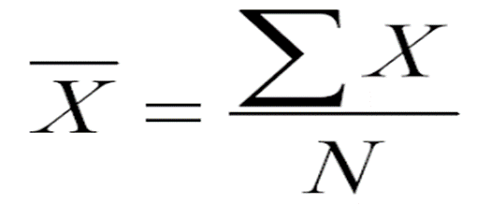
Descriptive Statistics
The two main techniques are for descriptive statistics are:
Mean
Median
Mode
N.B: Observations: This means the total number of records
Mean: This is the sum of observations divided the count of observations. The mean is the average of a set of values, calculated by summing all the values and dividing by the total number of values. The mean is the most popular measure of central tendency. This is commonly referred to as the average of a data set. The mean is calculated by summing up all the values in the data set and then dividing by the number of values in the data set. Since it incorporates all the values in the data set, any changes to the values will affect the mean.

Slide 8
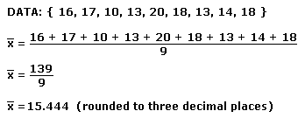
Descriptive Statistics
E.G.

Slide 9
Descriptive Statistics
Outliers: These are values that are abstract from the total values. Outlier are values that are unusual compared to the rest of the data set by being particularly small or large.
The mean may not always reflect the central position, especially when the data set has outliers. The mean value will be skewed by these values.
Mode: The mode is the value that appears most frequently in a data set. Mode is not affected by extreme values. It can be used for either numerical or qualitative data. If there are no repeating values in the data set, then the data set does not have a mode. For some data sets, there can also be more than one mode. It is possible to have two modes (bimodal), three modes (trimodal) or more modes within larger sets.

Slide 10
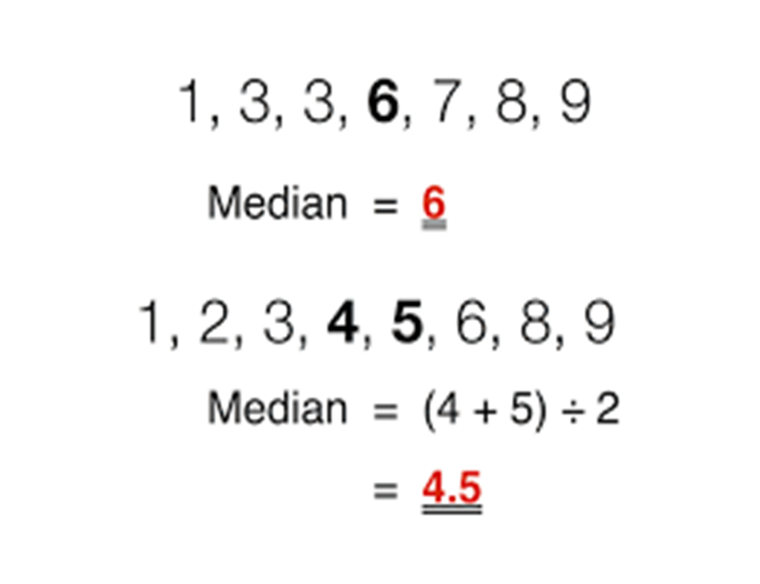
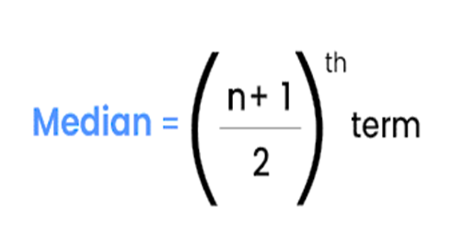
Median: The median is the middle value in the data set distribution. It splits the data set in half. In an ordered set of data, the median is the middle value such that 50% of all data lies above or below it. Median is less affected by outliers and skewed data. it is ordered from least to greatest.

Slide 11
Measure Of Variation
Measures of variation can be used in conjunction with measures of central tendency to give a more complete view of a data set. Each of these measures is used to determine the dispersion/scatter of values in a distribution.
The techniques used are:
Range: The range is the difference between the maximum and minimum values in a data set.where Maximum is the largest value in the data set and Minimum is the smallest value in the data set.
Range = Maximum-Minimum
Minimum, maximum, and range are very sensitive to outliers.

Slide 12
Measures Of Variation
Variance: The variance measures how spread out the values in a data set are from the mean. Variance tells how representative the mean is of each of the values in the data set.
The closer each individual value in the data set is to the mean, the smaller the variance will be.
If each value is at the mean in a data set, the variance will equal zero, which indicates that there is no variation from the mean across the entire data set. This mean that the values are the same as the mean.
The further each individual value in the data set is from the mean, the greater the variance will be, which indicates that the mean is not as typical of the individual values in the data set.
The size of the variance does not have any special underlying standard interpretation. Variance, along with the mean, allows you to judge how well the mean serves as a measure of central tendency.

Slide 13
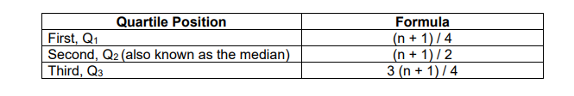
Measures of Variation
Standard Deviation: The standard deviation is a measure of the average deviation of each value from the mean.
Quartile: Quartiles in statistics are values that divide the data set into quarters according to where the values fall on the number line. They are often used in sales and surveys to divide population into groups.

Slide 14
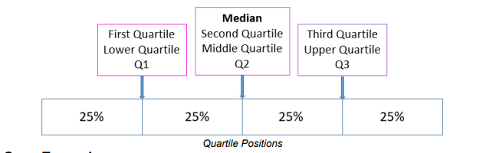
Measure of Variation
QUARTILE CONT’D
The three quartiles that divide a data set into quarters are:
• The median of the lower half of the data set (25th percentile)
• The median of the data set (50th percentile)
• The median of the upper half of the data set (75th percentile)

Slide 15
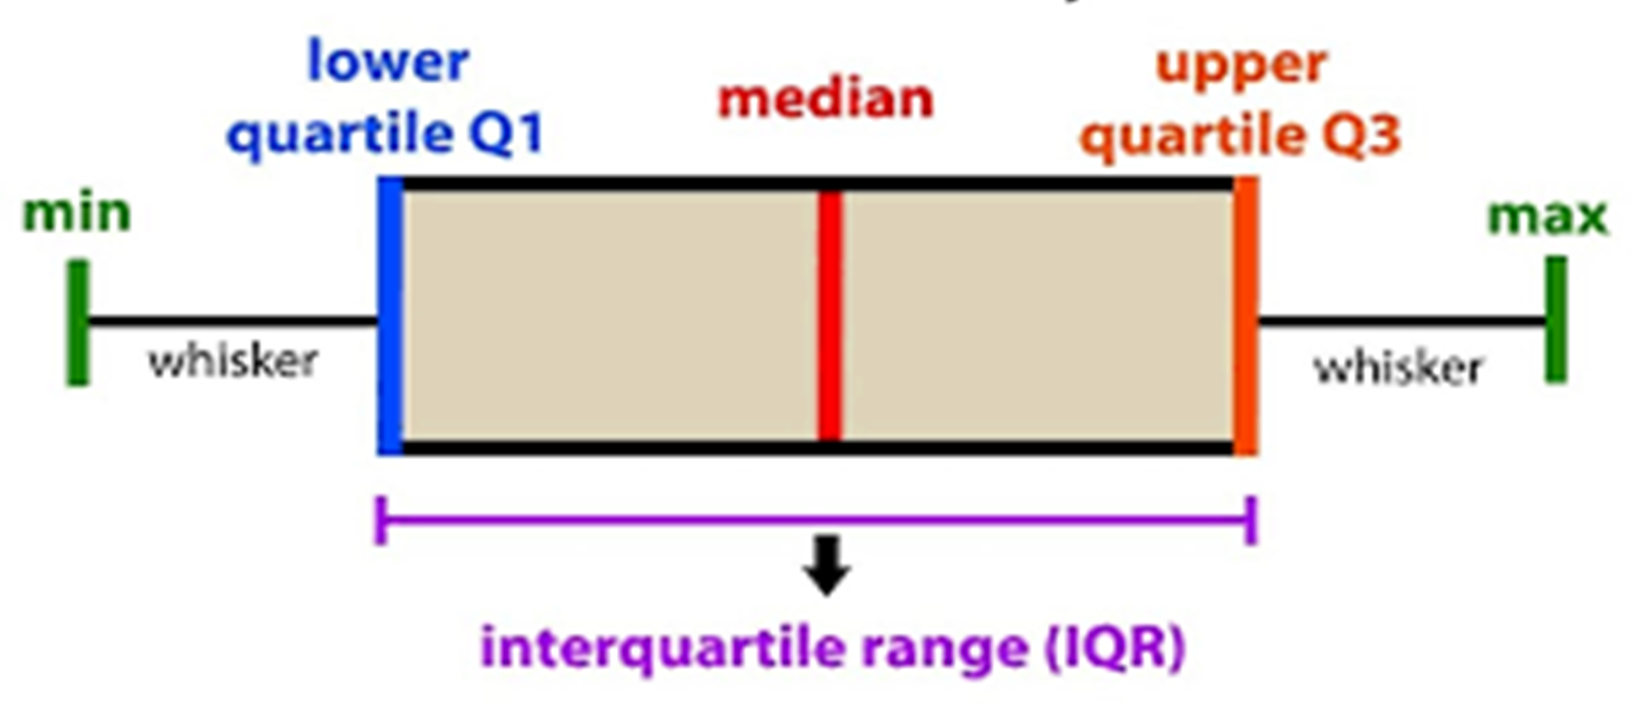
Measure of Variation

Slide 16
Measures Of Variation
Median (Q2): The middle value of the data set.
Quartiles (Q1 and Q3): Values that divide the data into four equal parts.
Interquartile Range (IQR): The range between the first (Q1) and third (Q3) quartiles, representing the middle 50% of the data.
Whiskers: Lines extending from the box indicating the minimum and maximum values within a certain range.
Outliers: Individual data points lying beyond the whiskers.

